Slide 1

TRAFFIC FLOW AND OPTIMISATION
By:
MITU22BTCS0377:- Om Yadav MITU22BTCS0247:- Isha Nar
MITU22BTCS0353:- Nikhil Thorat
MITU22BTC0678:- Ubaid Karbhari
Guided By:
Dr. Chandrashekhar Goswami
Department of Computer Science & Engineering, MITSoC, Loni Kalbhor

Slide 2
Outline
INTRODUCTION
PROBLEM STATEMENT
OBJECTIVES
FEATURES
CONCEPTS AND METHODS
LITERATURE SURVEY
TOOLS AND LANGUAGES
CONCLUSION AND FUTURE WORK
REFRENCES

Slide 3
1. Introduction
Our innovative idea named Traffic flow and Optimisation is a platform offering a streamlined and traffic congestion free campus. As our campus courses continue to expand, it becomes increasingly important to develop innovative solutions to mitigate the adverse effects of traffic congestion and improve the overall flow of traffic and ease the parking system that saves time and human efforts.

Slide 4
2. Problem Statement
In order to reduce traffic congestion as well as bring an optimum solution to the problem which makes it easy for both students and faculties to reach their respectable destination in time.We propose our problem statement “To develop an AI based system that predicts traffic congestion in our collage (MIT ADT) based on real time input and other data using RFID.”

Slide 5
3. Objectives
The main objectives of the project are:
Improved traffic flow: The algorithm will focus on reducing traffic delays, thereby enhancing the overall flow of vehicles on the road. This will lead to shorter travel times, reduced fuel consumption, and decreased greenhouse gas emissions.
Reduced Congestion: By optimising traffic timings, we aim to alleviate congestion hotspots and reduce the likelihood of gridlock, making travelling more convenient and less stressful for everyone.
Enhanced safety: Optimized traffic timings can lead to safer road conditions by minimizing conflicts at intersections and reducing the likelihood of accidents.
Environmental benefits: Reduced congestion and smoother traffic flow can contribute to lower carbon emissions, as vehicles spend less time idling and accelerating.
Economic efficiency: Improved traffic flow can have a positive impact on the economy of the collage as there will be less damage on the roads.
Proper Parking: As there will be proper information of parking spacing no space will be wasted or over occupied.

Slide 6
4. Features
Manage Vehicle Parking
Available and Empty Parking Indicator
List parking history
Vehicle Category
Total Parking Time Stamp

Slide 7
5. Concepts and Methods
User-Friendly Design: Make the use of RFID to scan the location of the vehicle and suggest a parking place.
Allocates entry and exit routes.
Proper display of available parking spaces and allocated ones and route guidance
Allow the person to write about occupied parking spaces.

Slide 8
6. Literature Survey
literature survey for Traffic Flow and Optimisation typically involves researching and reviewing existing literature, research papers, articles, and books related to various aspects of traffic. Below, are some literature survey
Traffic Flow Theory: Understanding traffic flow is fundamental to traffic optimization. Various traffic flow theories have been developed. These models form the basis for designing algorithms to optimize traffic flow.
Traffic Data Collection: To optimize traffic, data collection is essential. This involves gathering the data of total number of students and faculties as well as knowing their vehicle type for allocating parking spaces.

Slide 9
7. Tools and Languages
It is a Web Application, and we have used Python programming language, MYSQL for database creation and PyCharm IDE Platform.

Slide 10
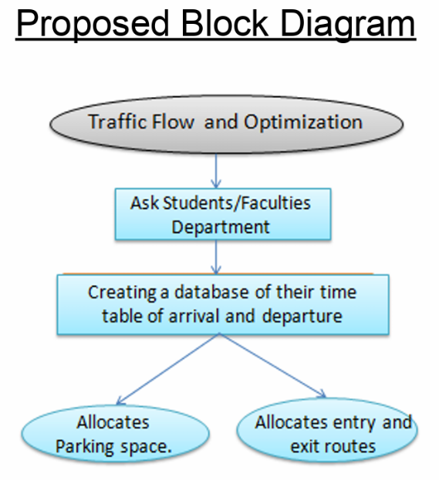
8. Process and Architecture
Requirements Gathering and Planning:
Data Collection and Preprocessing: Gather relevant traffic data, including real-time and historical traffic patterns, vehicle counts, and congestion levels.Preprocess and clean the data to remove outliers and inconsistencies.
Algorithm Development: Develop the optimization algorithm. This may involve various techniques, including machine learning, optimization methods, and rule-based systems. Considering factors such as students arrival and departure time, their parking spaces allocation and their conveniences.
Estimating the parking spacing and dividing it according to the vehicle types.

Slide 11
9. Implementation
Planning and Research: Identifying and understanding the needs of students and faculties.Followed by proper research and framework
Traffic Flow Modeling: Implement a traffic flow model, such as certain flow charts and algorithm or other relevant models, Use of certain simulation software to build and validate the model.

Slide 12
10. Conclusion and Future Work
The development and implementation of our Mini project “Traffic Flow and Optimisation” is reaching collage hassle-free and successfully parking your vehicle and updating in it using RFID.

Slide 13
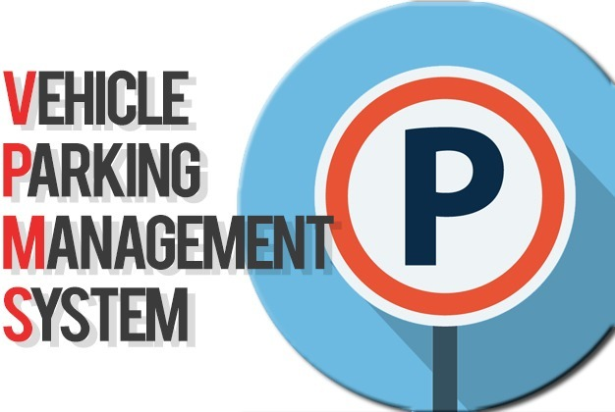
Home Page

Slide 14
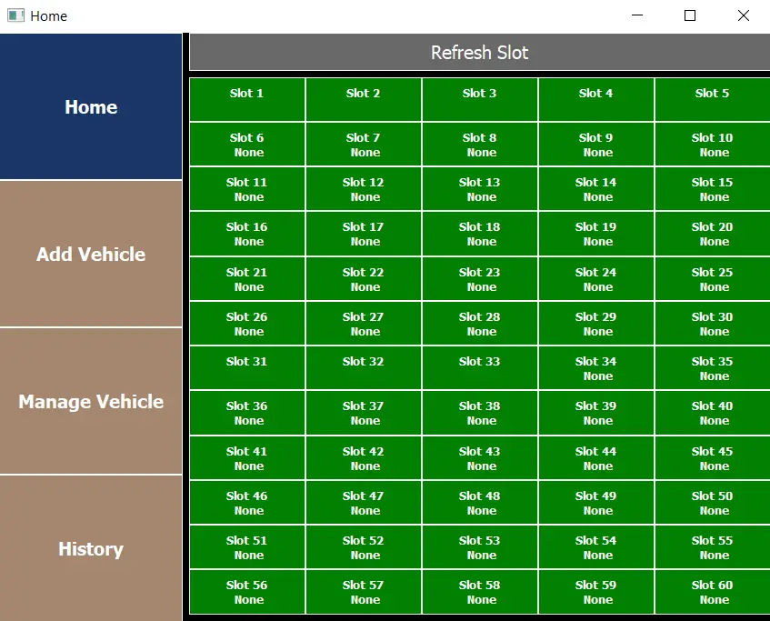
Project Output

Slide 15
References
Elhenawy, M. S., & Mousa, H. A. (2019). Real-Time Traffic flow Control System Using Deep Reinforcement Learning. IEEE Access, 7, 22051-22061.
Xie, K., Wang, S., Huang, B., & Liu, L. (2018). Traffic Signal Optimization for Sustainable Transportation Using Deep Reinforcement Learning. IEEE Transactions on Intelligent Transportation Systems, 20(7), 2563-2572.
Wei, W., Pan, Y., Zheng, N., Wu, L., & Cai, Y. (2018). Learning Traffic Signal Control from Demonstrations. Proceedings of the ACM on Interactive, Mobile, Wearable and Ubiquitous Technologies, 2(2), 71.
Nishio, A., & Okamoto, M. (2019). Deep Reinforcement Learning for Traffic Signal Control in Autonomous Vehicle Environment. IEEE Transactions on Vehicular Technology, 68(1),
442-455.
Mahmassani, H. S., Chu, X., Yao, T., & Herman, R. (2010). Evaluation of Real-Time Adaptive Traffic Signal Control: Case Study of the Dallas Arterial Field Test. Transportation Research Record: Journal of the Transportation Research Board, 2159(1), 1-12.
Alirezaei, M., & Marandi, A. S. (2013). Adaptive Traffic Signal Control: A Field Study.
Transportation Research Part C: Emerging Technologies, 34, 123-138.

Slide 16
Thank You

